Slide 1


Slide 2
About the Assembly
A smart lab based out of In5 since Dec 2014
Over 200 free workshops done
ASSEMBLY: HACK - Embedded systems, iOT and hardware
ASSEMBLY: CODE - Software projects - APIs, frameworks, apps
Age range: 16-60 - students, professionals, entrepreneurs
Focus on smart technology and practical applications
Forum: members.theassembly.ae

Slide 3
TAG US ON OUR SOCIAL MEDIA
FACEBOOK
TWITTER
INSTAGRAM
YOUTUBE
The Assembly (@MakeSmartThings)
@MakeSmartThings
@MakeSmartThings
The Assembly

Slide 4
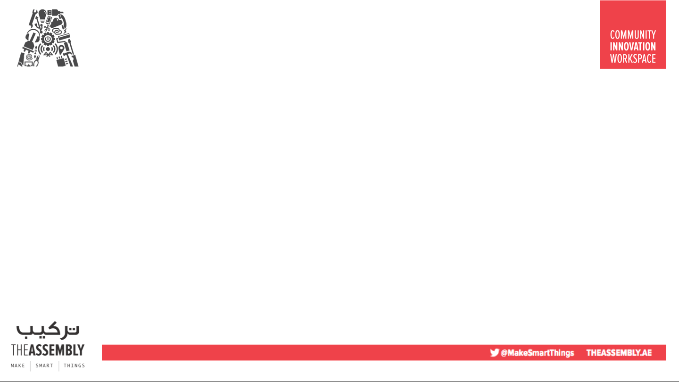

Overview
TOPICS:
WebVR
A-Frame
AR.js
Markers
Default Object
Image as a Object
https://github.com/The-Assembly/Ar.js_TreasureHunt
Treasure Hunt

Slide 5
Recap
Introduction to WebVR with A-Frame
Home automation using Augmented Reality.
https://github.com/The-Assembly/WebVRIntro.git
https://github.com/The-Assembly/AR-HomeAutomation.git

Slide 6
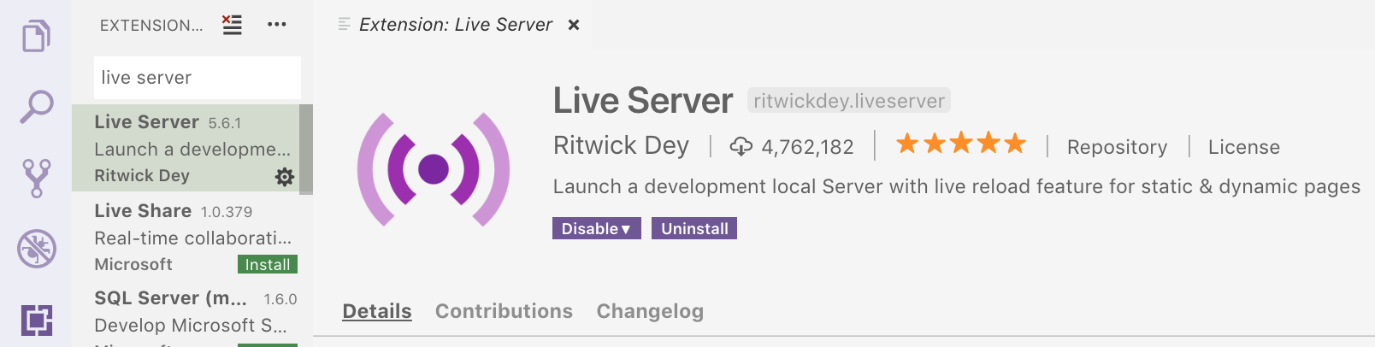
Software
Code Editor – Microsoft Visual Studio Code
Extension in VS Code (Live Server – Ritwick Dey)
https://code.visualstudio.com/

Slide 7
+
+

Slide 8
1. /usr/bin/ruby -e "$(curl -fsSL https://raw.githubusercontent.com/Homebrew/install/master/install)"
https://nodejs.org/en/
2. brew install node

Slide 9
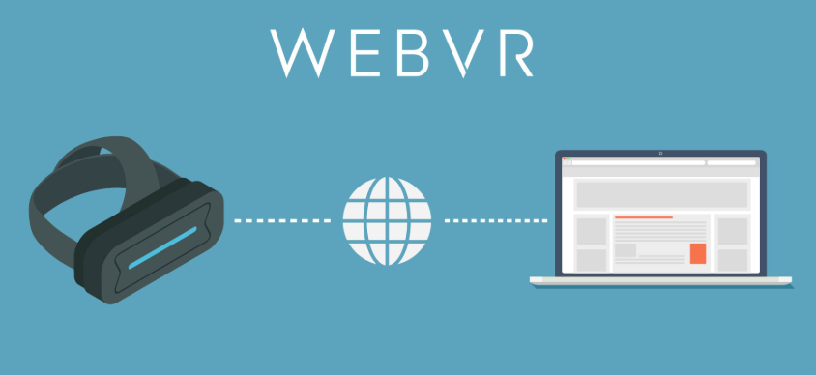

What is WebVR?
WebVR is an open specification that makes it possible to experience VR in your browser. The goal is to make it easier for everyone to get into VR experiences, no matter what device you have.
Notes:
The goal being augmented reality features directly on web browsers without sacrificing performance.
It is a pure web solution, so no installation required.
It is completely open source and free of charge
works on any phone with webgl and webrtc.

Slide 10
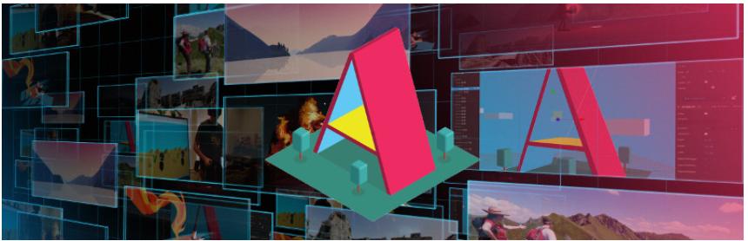
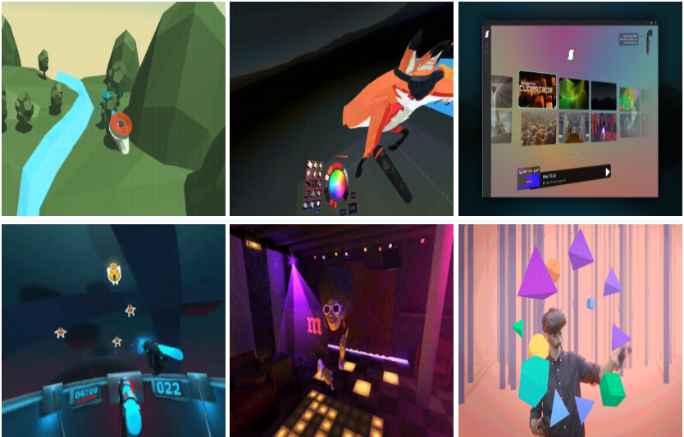
What is A-Frame?
A-Frame is an open source web framework for building virtual reality (VR) experiences. It is an entity component system framework for Three.js where developers can create 3D and WebVR scenes using HTML.
Notes:
It is not just a 3D scene graph or a mark-up language; the core is a powerful entity-component framework that provides a declarative, extensible, and composable structure to three.js(cross-browser JavaScript library and Application Programming Interface (API) used to create and display animated 3D computer graphics in a web browser) .

Slide 11
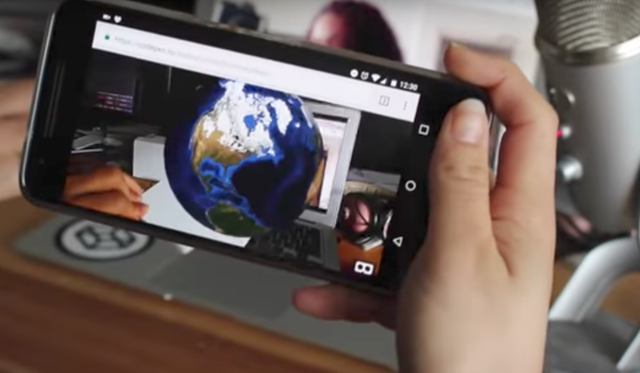
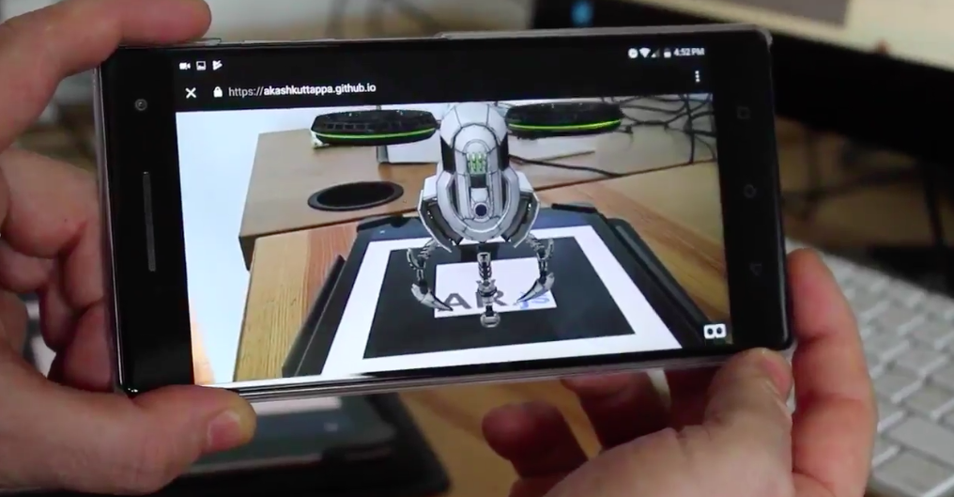
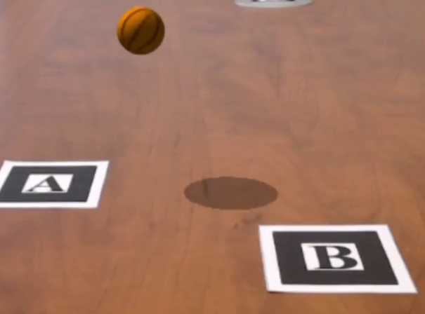

What is Ar.js?
Ar.js is a JavaScript framework acting as a port of AR Toolkit, while leveraging other packages like a-frame and three.js.
Notes:
The goal being augmented reality features directly on web browsers without sacrificing performance.
It is a pure web solution, so no installation required.
It is completely open source and free of charge
works on any phone with webgl and webrtc.

Slide 12



Markers
An important feature of AR.js is the possibility to use custom markers, the default type is ‘pattern’.
https://jeromeetienne.github.io/AR.js/three.js/examples/marker-training/examples/generator.html

Slide 13
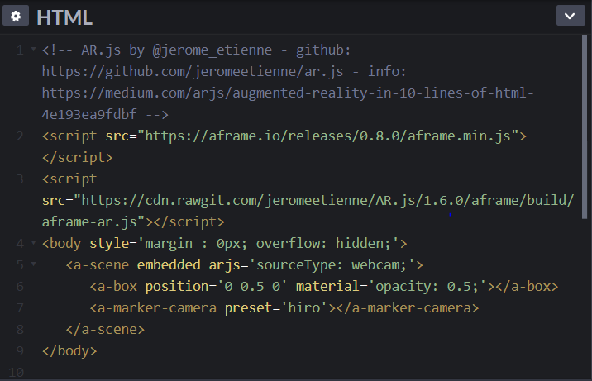
Default Object

Slide 14
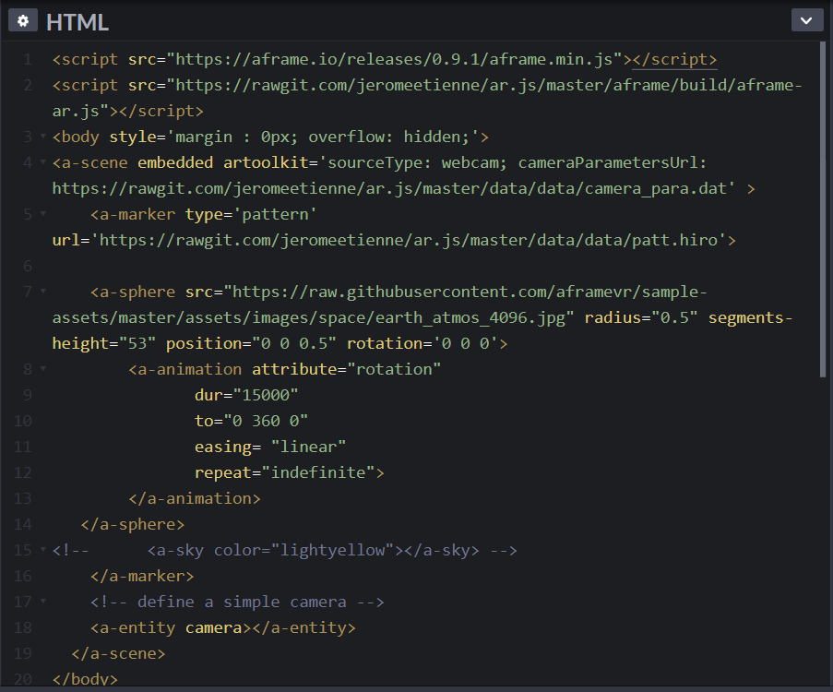
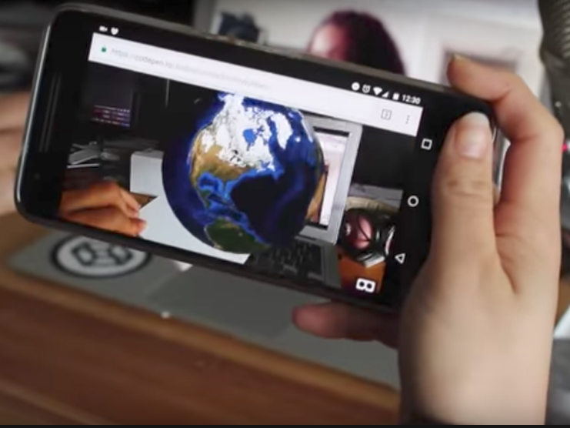
Image as a Object

Slide 15
Treasure Hunt!

Slide 16
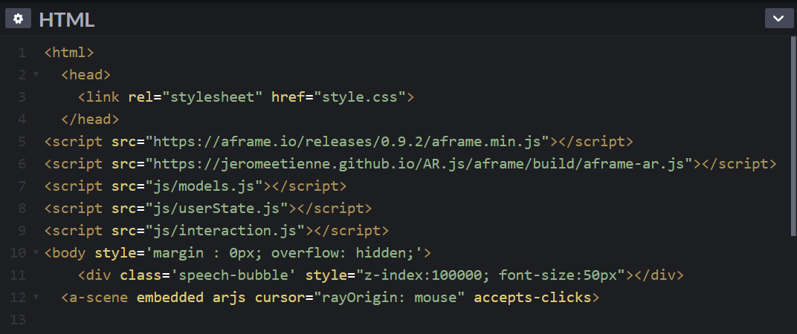
Importing libraries

Slide 17
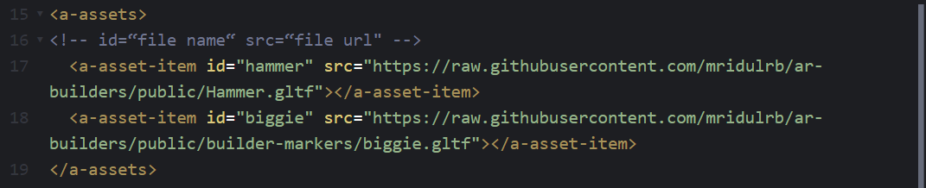
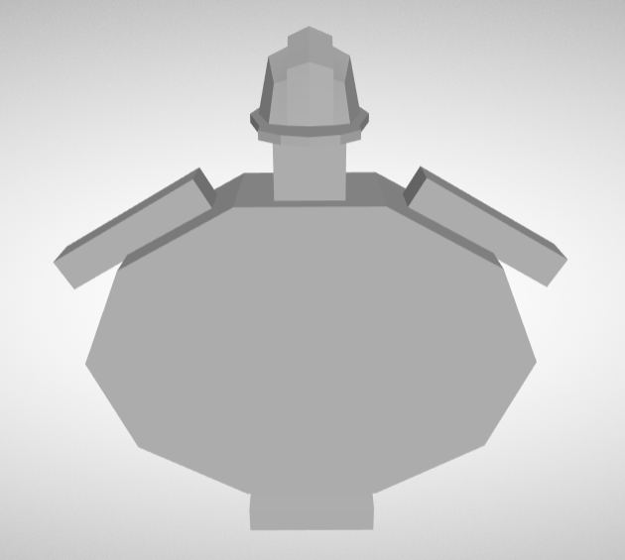
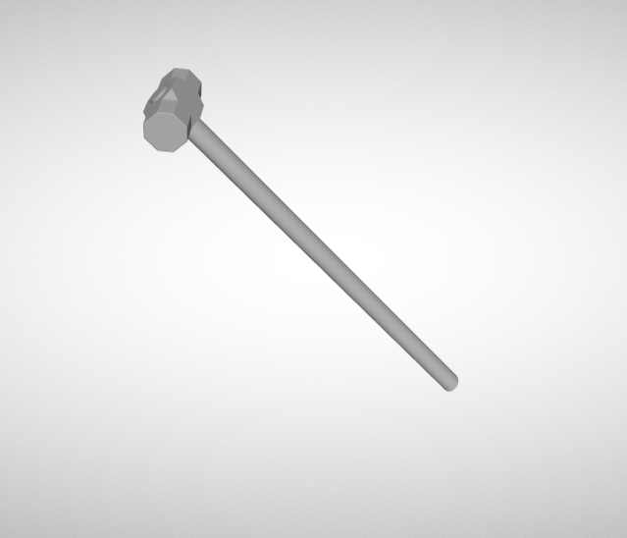
Importing the character and tool
biggie.gltf
Hammer.gltf

Slide 18
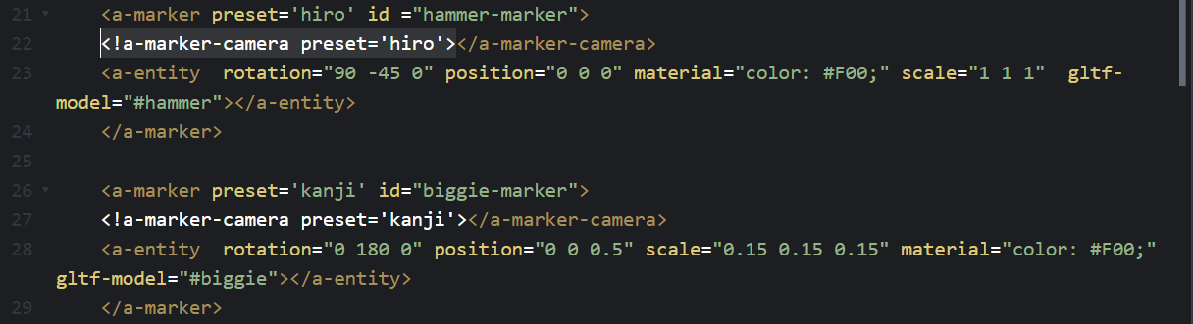


Adding markers
Marker for hammer
Marker for Biggie

Slide 19
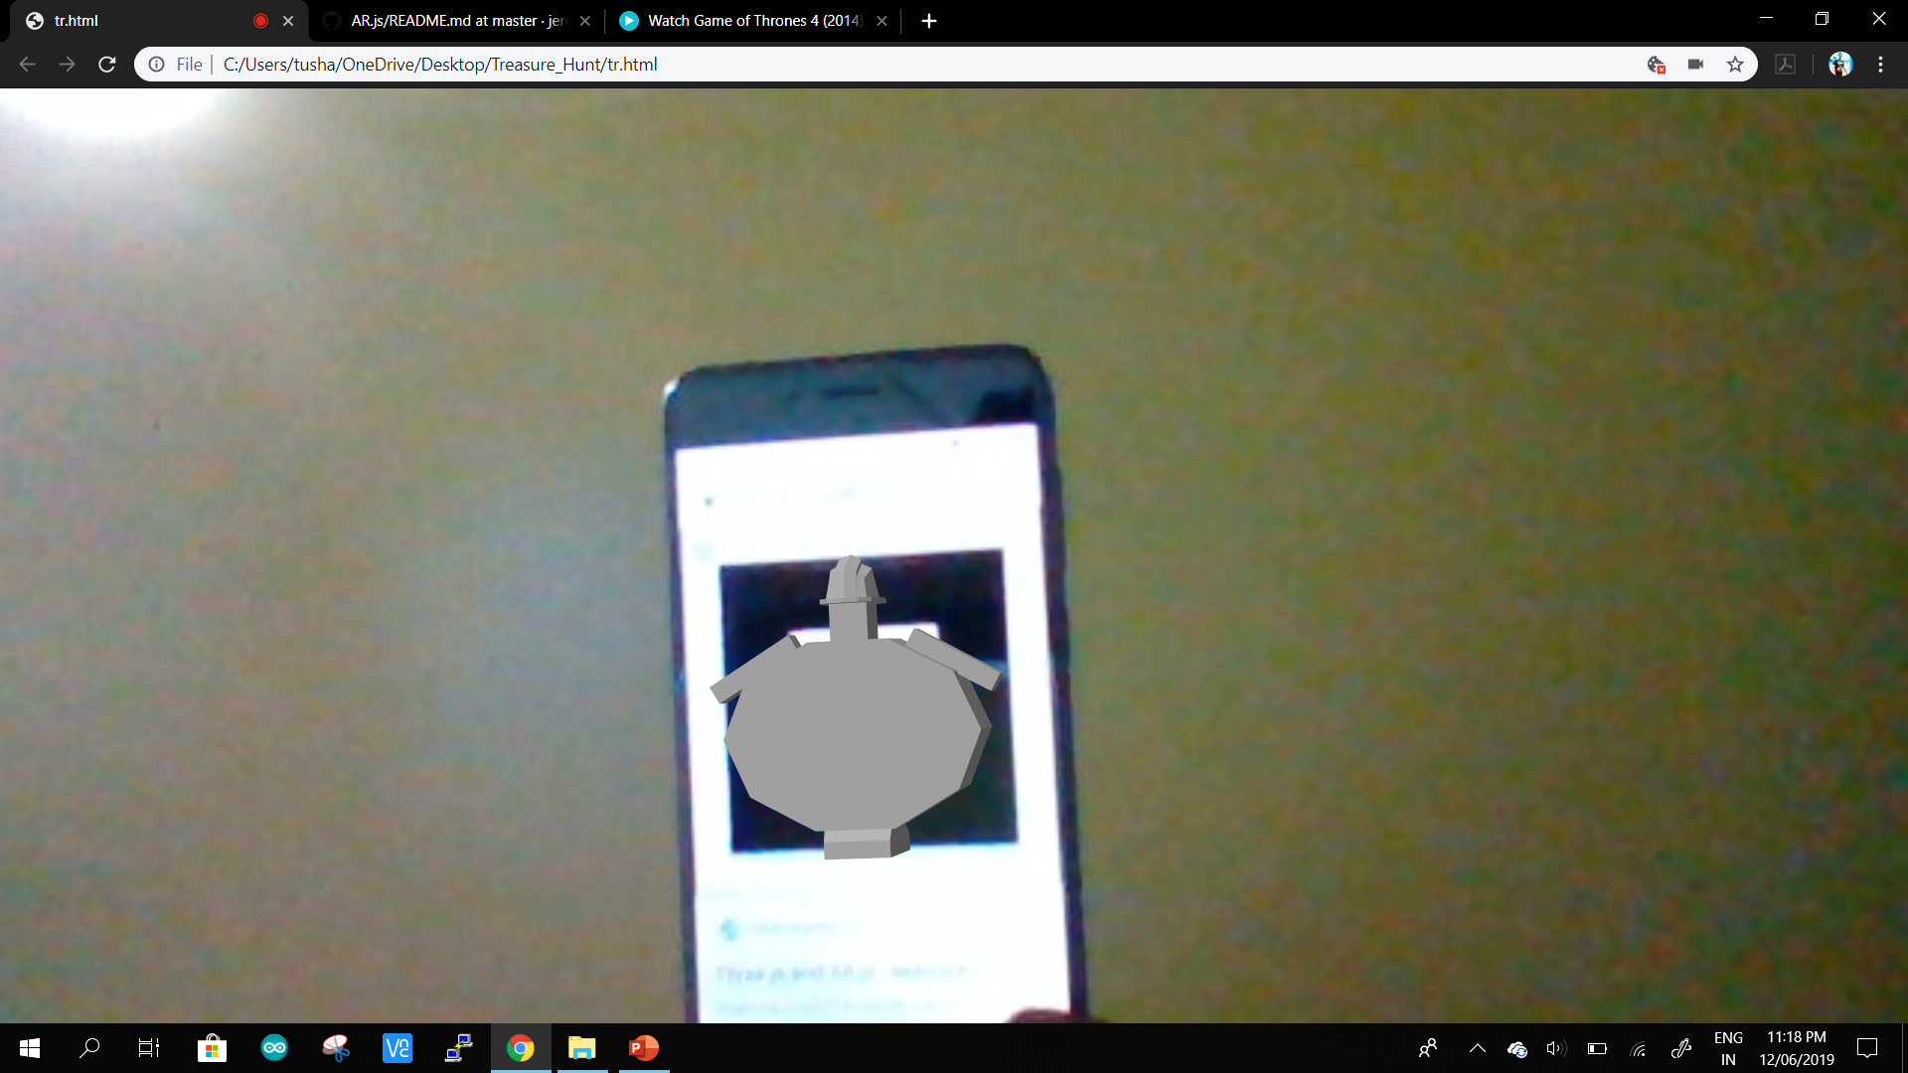
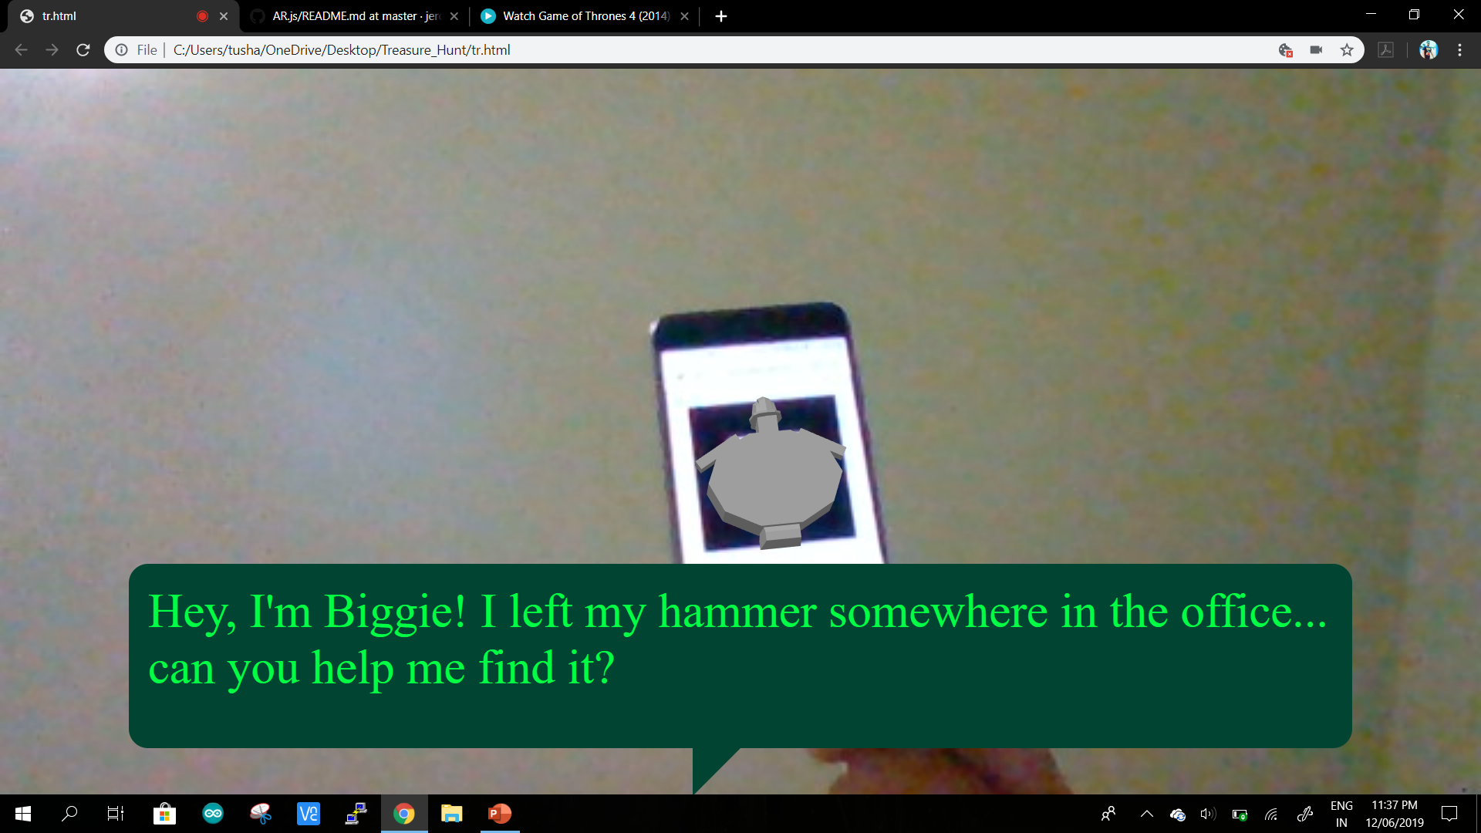

Slide 20
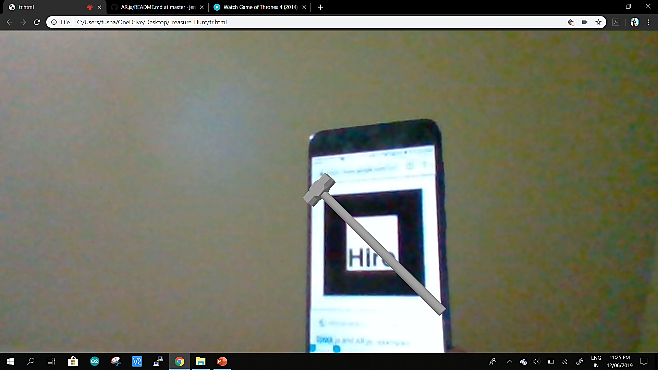
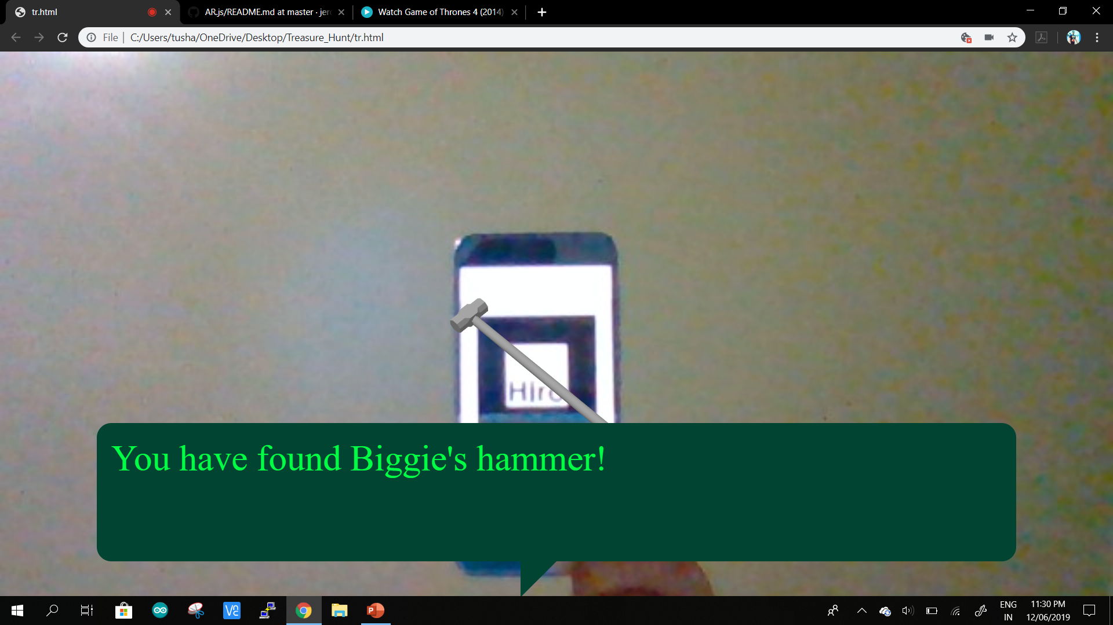

Slide 21
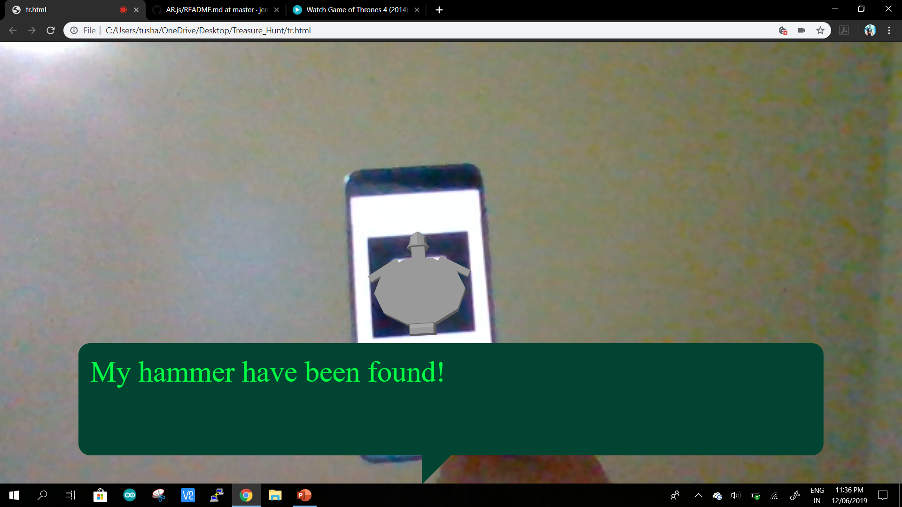

Slide 22
THANK YOU!

